Slide 1
Content Marketing
Section 3 – Part I

Slide 2
Content Marketing
“Content marketing is the only marketing left.” – Seth Godin
Definition: Content marketing is a strategic marketing approach focused on creating and distributing valuable, relevant, and consistent content to attract and retain a clearly-defined audience — and, ultimately, to drive profitable customer action. (Content Marketing Institute)
Consumers have shut off the traditional world of marketing. They own a DVR to skip television advertising, often ignore magazine advertising, and now have become so adept at online “surfing” that they can take in online information without a care for banners or buttons (making them irrelevant). (Content Marketing Institute)

Slide 3
How Content Marketing has Changed
“We’ve seen changes take place when it comes to search engine marketing too. Where once companies gamed the system in order to appear higher in the ranking using black hat tactics, now algorithm changes are forcing businesses to create good content in order to rank well. The use of content mills and other poor-quality writing services has reduced dramatically as algorithms have changed so that bad spelling and grammar are picked up and sites penalized.”
“The upshot of all of this is that businesses that seriously want to compete online now have to look for less traditional means of reaching customers. Not only this, but these means have to be carried out in line with search engine rules. Many companies now produce a company blog, but don’t always go about it in the right way.”
Resource: Why Your Business Needs Content Marketing (Kerry Butters)

Slide 4
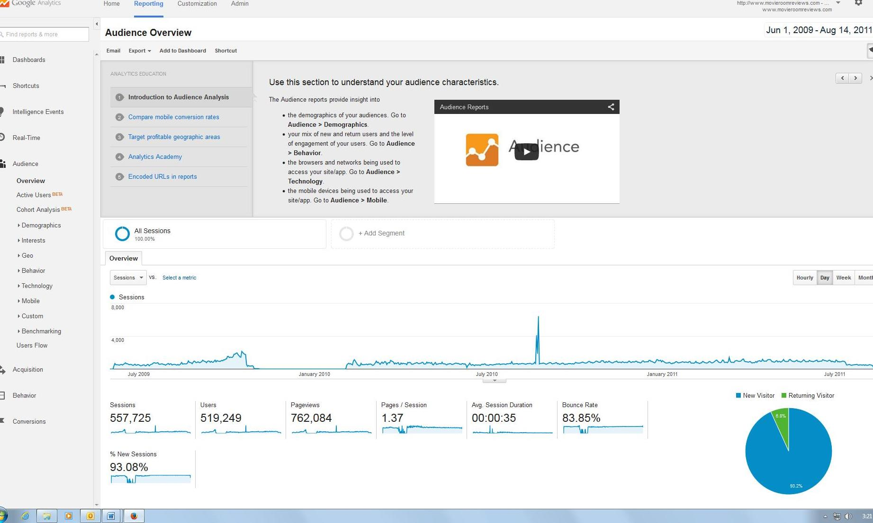
Neil’s “Content” Profile – MovieRoomReviews.com (2009-2011)
Site achieved PageRank 4

Slide 5
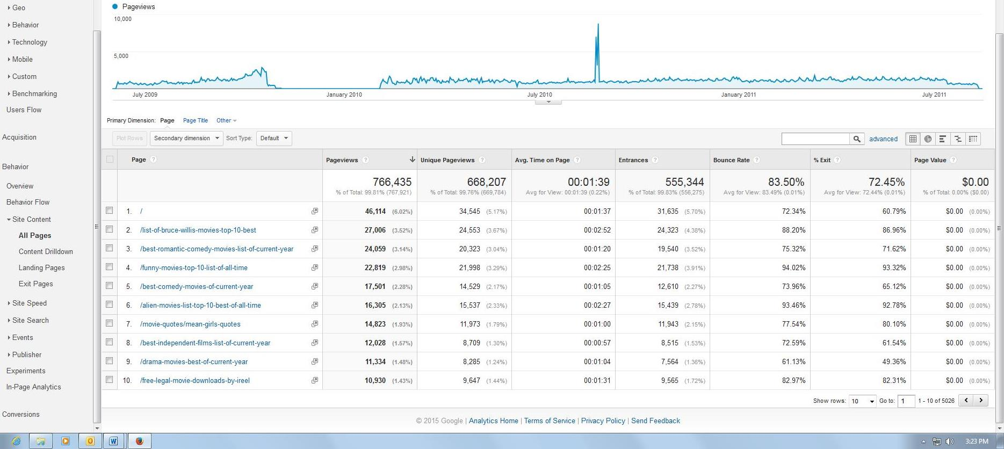
MRR Content Top 10 of 5,026 pages

Slide 6
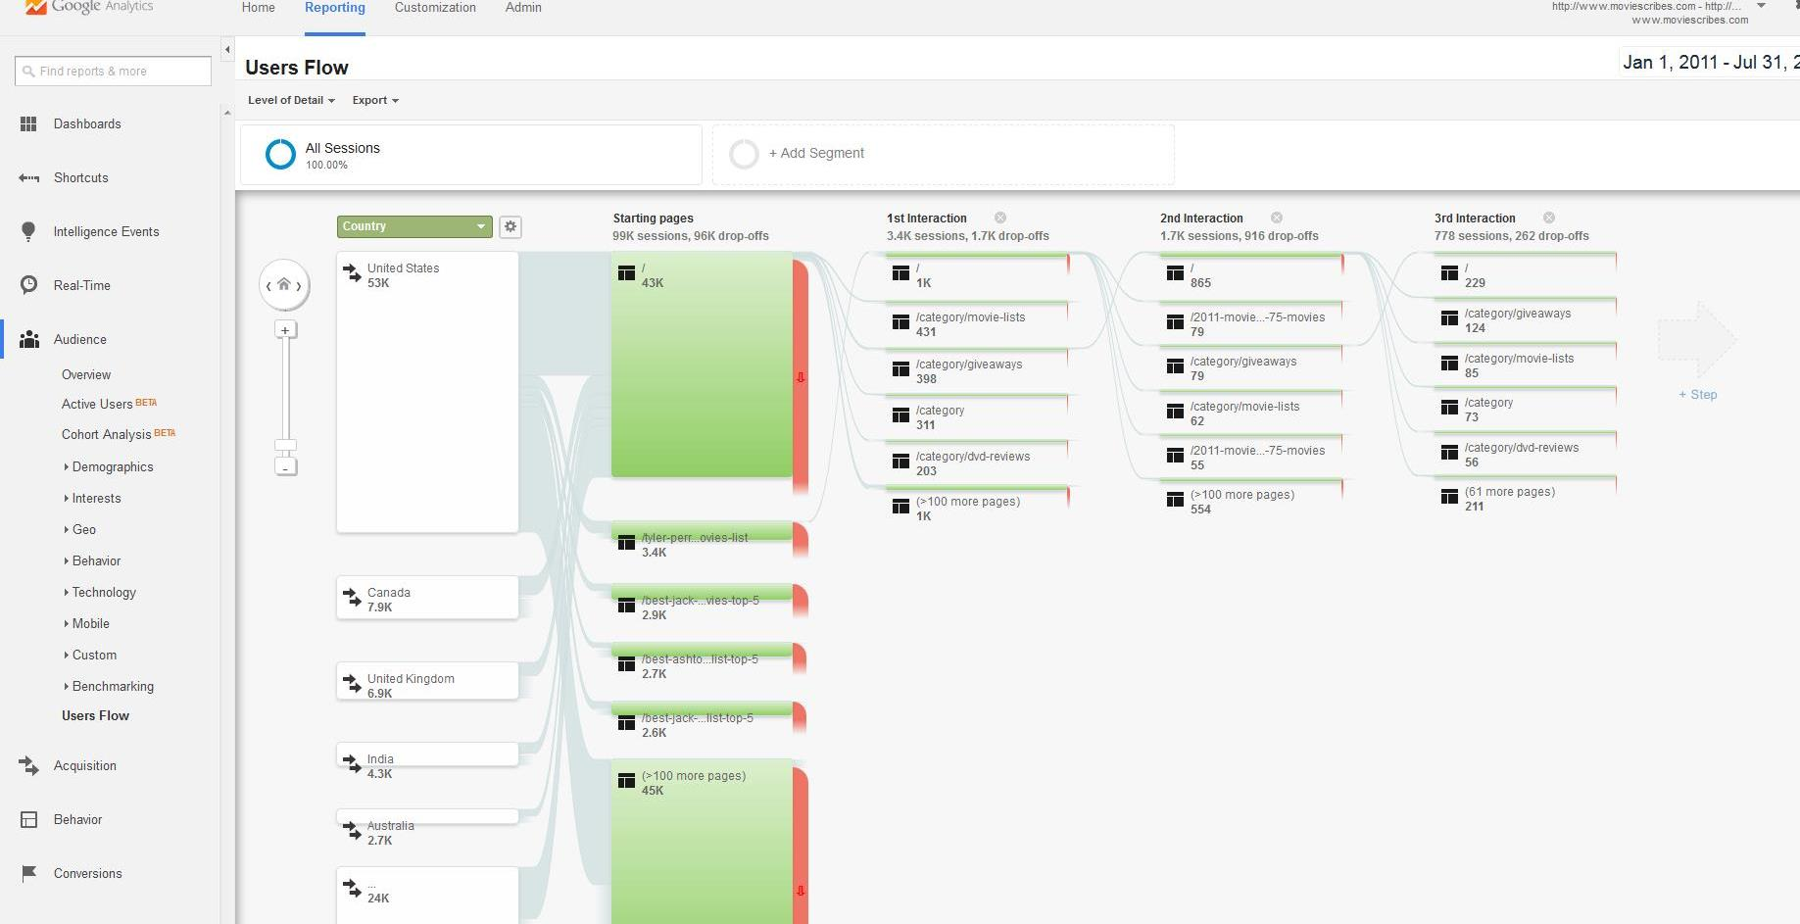
Sold MRR in late 2011 and started MovieScribes.com
Top posts 3-4K sessions during 6 months
Operated for about 6 months and then sold

Slide 7
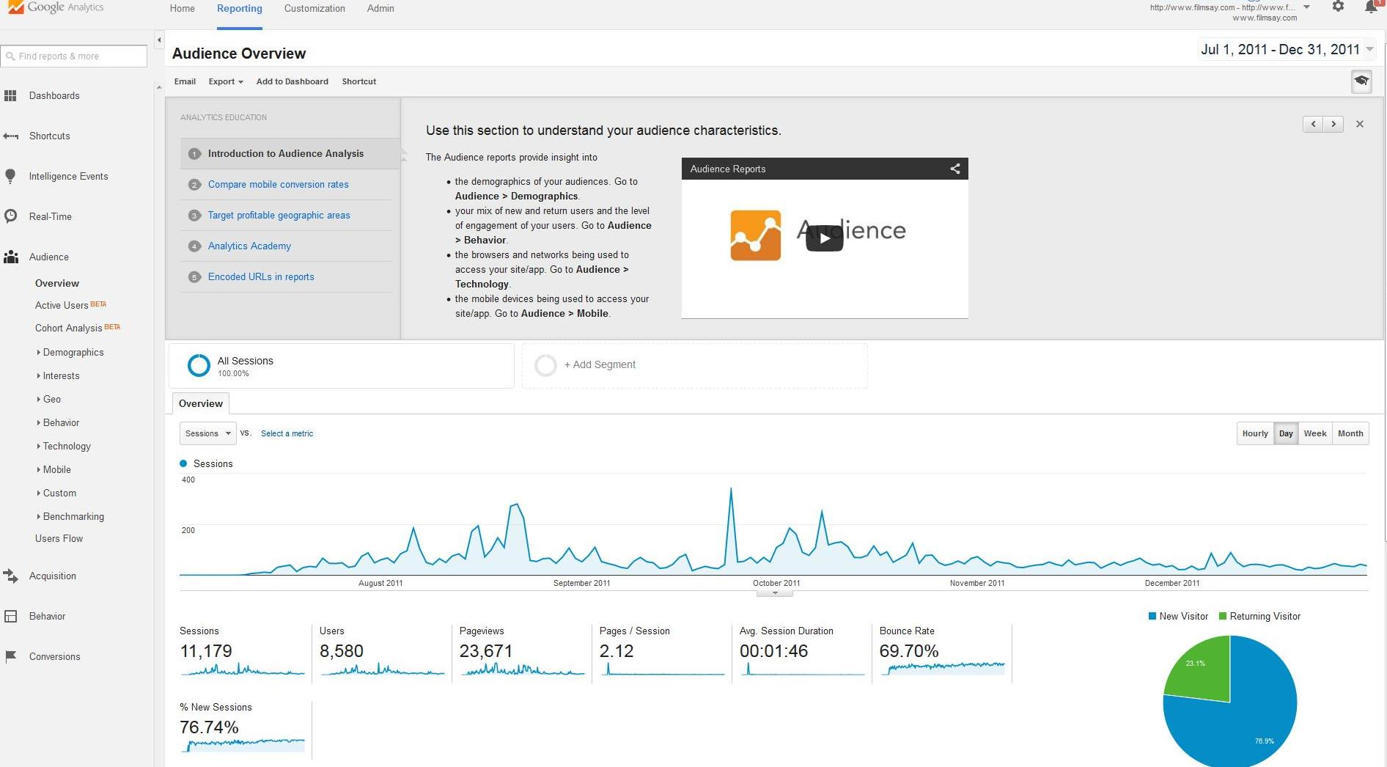
Started FilmSay in July 2011 – less than 6 months (Sold)
Improved engagement w/forums & social tools

Slide 8
BookRoomReviews.com
2009-2013
Started as book review site
Transitioned into children and family reviews, etc.
Sold in 2013
Similar traffic and revenue to MRR
Also launched GameRoomReviews.com in 2009, but limited development

Slide 9
Freelance Content Writing
Started in 2008 w/ ifreelance.com
Developed direct clientele after initial projects and through writing service websites
Wrote articles, resumes, cover letters, marketing collateral, etc.
2010+ Much of work through large content marketing firms for third-party clients

Slide 10
Content Writing Opportunities
Excellent writing skills offers you a ginormous opportunity to make money creating online content in the current online environment.
You can find and write for direct clients, or get “hired” to create content for clients through a third-party service provider (greater access, but the provider takes a cut)
Develop your own website/blog around a passion
Build content
Employ SEO
Attract an audience
Send newsletters
Drive traffic
Sell Advertising

Slide 11
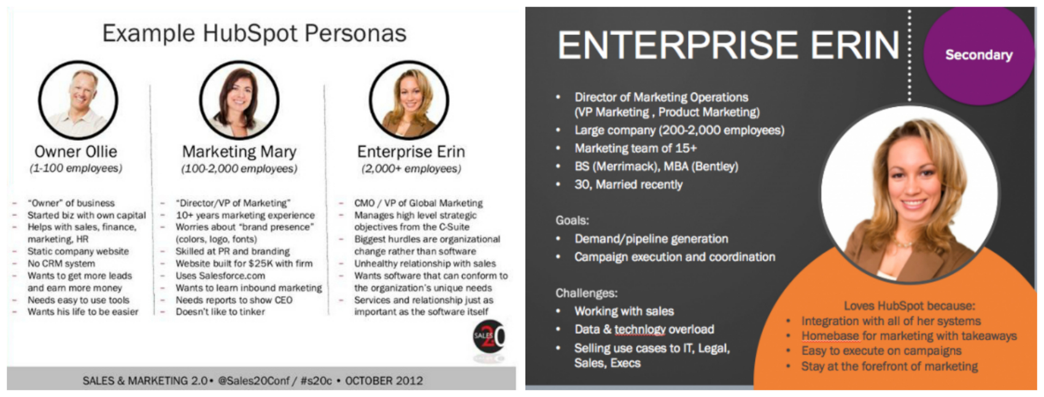
Building Content to Buyer Personas
Identify the target market for each of your solutions or offerings (information, entertainment, etc.)
Create persona
Identify key questions/problems this person searches to find resolutions
Build content to answer these questions

Slide 12
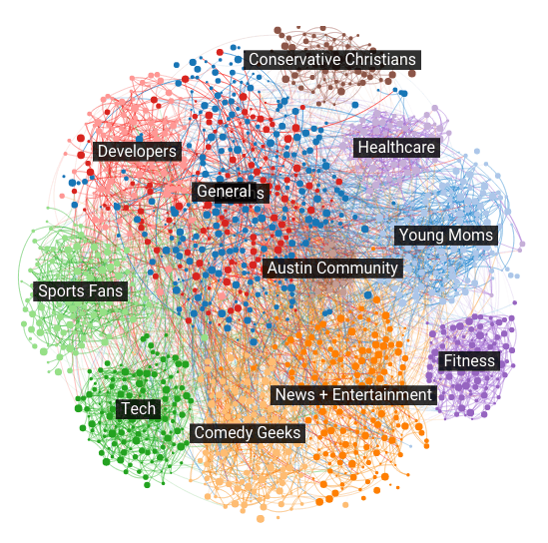
Crafting Content Based on Interests on Target Personas – Fitbit Example
http://app.mhb.io/e/m1oy/57

Slide 13
Journey-Based Personas
Common to build personas based on buyer stage in B2B
Align content with buyer’s current position within the buying journey
Typically flow is from initial education (ie. Blog content) to desire for more in-depth knowledge (ie. Whitepaper or case study) to specific solution landing page (on website) through call-to-action
Pardot: Understanding the Buyer’s Journey (Awareness, Consideration, Decision)

Slide 14
Forms of Content
Newsletters
Blogs
Social Media Updates
White Papers
eBooks
Podcasts
Webinars
Video
Photography/Image Creation
Specific content formats lend themselves to different points in the buyer’s journey

Slide 15
Content Formats
Blog (short-form and long-form)
Whitepaper
Case Study
Reports
eBook
Video
Specific content formats lend themselves to different points in the buyer’s journey

Slide 16
Content Marketing Exploration (Small Group)
Consider a potential business problem (ie. “How to improve sales forecasting” or “How to succeed in social media marketing”)
Ask Google (through a search) for help/information
Select 2-3 of the first organic (no “Ad” links) resources that show up
Scan through the content/information.
***Identify the “motive” for the publisher sharing the content (ie. Is it a content medium or a business blog)
***Identify the call-to-action (CTA) at the end. What is directed?
***If you were to respond to the CTA, what do you think would happen in the next stage? What would be the CTA with that content? (Applies to “business” content)

Slide 17
Company Blog
Creates interactive platform to establish credibility, create conversation with the audience and indirectly promote
Also provides method to generate SEO traffic, drive sharing, create links and expand readership
Writtent: Anatomy of a Perfect Blog Post

Slide 18
Rules for Online Content
Different from traditional print media
Visual elements are very important
Make it scannable
Use subheadings
Craft a compelling introduction
Use a conclusion in most cases
Create a call to action for marketing/sales content
Use “markdowns” – eg. Bold, blocked quotes, underlines, etc.
Short paragraphs to keep reader engaged
Writtent: Ultimate Guide to the Perfect Blog Post (22-point)

Slide 19
Making Content Scannable
Use bulleted lists (also generate more links/shares)
Use bold, capitals, italics, underlining, etc. (Markdowns) to emphasize key points (and to make keywords stand out – bold)
Headings/subheadings (use H1-H6 title tags sequentially)
Incorporate pictures – research suggests creates natural progression of eyes through article (tag for search engine image searches)
Use borders and box quotes to key points stand out
Use white space creatively (don’t make content appear overwhelming)
Write concisely, but with an engaging style
Reinforce main points; typically have a “conclusion” type section
Stay focused on one theme with a few supporting points
Darren Rowse, ProBlogger

Slide 20
Video Content Marketing Example
Jordan Kilganon: All-Star Game Demo
YouTube Channel/Promotion: Channel Video & Promotion
Website: http://bouncekit.com/

Slide 21
Article Marketing
Disseminating articles in off-site platforms
Helps build credibility
Creates SEO links
Drives Web traffic through links and landing pages
Examples:
Ezine.com (SEO benefit hugely devalued a couple years ago by Google)
GoArticles.com
Quora.com

Slide 22
Guest Blogs
Articles posted on other blogs with by-line
Build credibility
Acquire link backs
Must be careful about quality of site/blog where you post and the volume of link backs
Google has become very cognizant of excessive use of guest blogging to generate links (can lead to penalty)

Slide 23
Sponsored Post
Google generally detests them, but they are hard to detect when well-written
Do-Follow vs. No-Follow links
Great way for publishers to generate revenue from strong PageRank
Similar to advertorials in a magazine, but Google watches closely if they appear too “spammy”
Use 1-2 outgoing links maximum
Ensure content is closely tied to links/anchor text

Slide 24
Sharing
Content is not a standalone tool
Balance emphasis on SEO with shareability
Incorporate sharing buttons
Open-source development tools have plug-ins to use in planting social sharing buttons
A lot of online media sites don’t include “Print” option any more to drive people to share articles electronically

Slide 25
How to Create Shareable Content
http://www.socialmediatoday.com/marketing/2015-04-28/how-create-content-so-shareable-youre-guaranteed-tweet

Slide 26
Content Marketing Tools
SlideShare & Prezi (Presentation Sharing – can include links)
Listly (Polls, surveys, etc.)
Quora
http://www.wordstream.com/blog/ws/2014/07/28/free-content-marketing-tools

Slide 27
Make People Blush!
One of the most effective ways to generate traffic and garner loyalty is to call positive attention to people and organizations.
Examples: Top 5 Experts, Great People Doing…, Organizations That Help the Community, etc.
Include those mentioned in your social distribution
People are flattered by compliments, and will often share your work with their followers
Eg. Our Fashion Show recap worked well on Facebook/Twitter based on sharing with all of the people/places involved in the event. (examples in social media section)

Slide 28
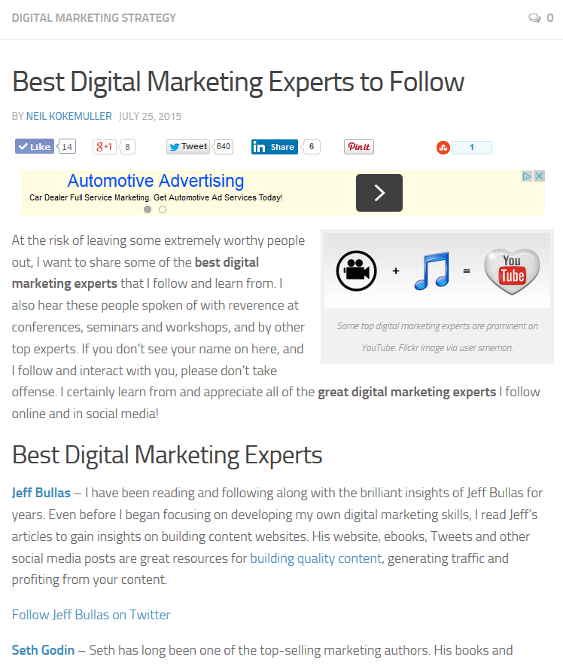
Over 500 shares within 3 weeks. Snowball effect w/ 10-15 new Tweets per day.
Included brief bios and direct link to follow on Twitter
Added add’l bullet list at bottom for more shares
Shared with all mentioned and most shared

Slide 29
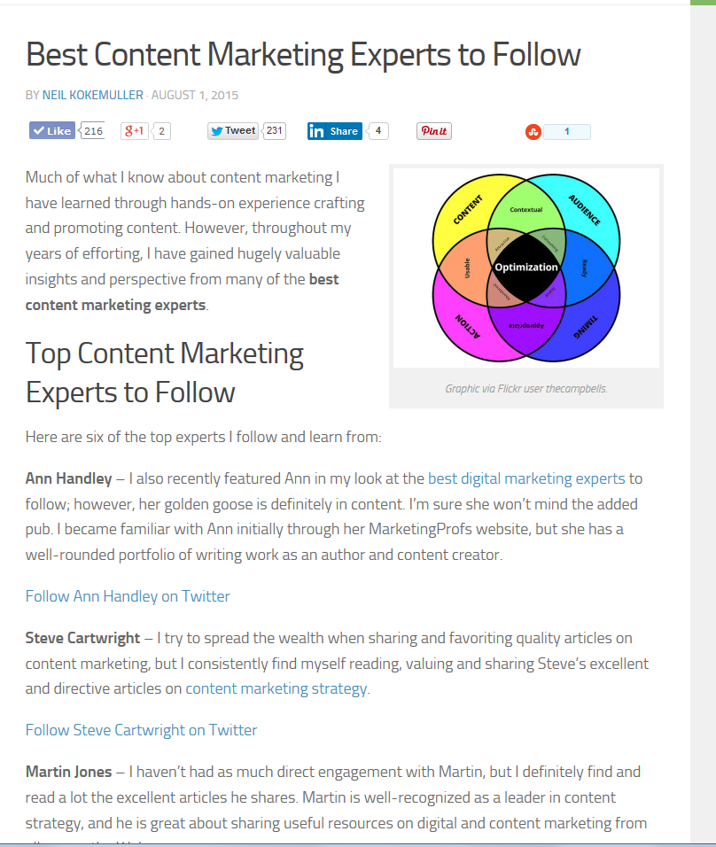
This one got a bit more play on FB as well due to a few “experts” posting on their pages.

Slide 30
Grow Traffic by Growing Subscribers
http://blog.hubspot.com/marketing/grow-blog-subscribers-grow-traffic
Feed subscribers get automatic updates on new content
E-mail subscribers allow you to send periodic updates/newsletters that highlight new products, features and content

Slide 31
Importance of Content Marketing
Review Key Data Points and Content Formats
http://www.marketo.com/resources/content-marketing/

Slide 32
Content Marketing Editor Tools
Resource: http://www.outbrain.com/blog/proofreading-editing-tips-tricks-and-tools-to-protect-a-content-marketers-credibility

